Slide 1
Source Generators in .NET
By Vahid Farahmandian

Slide 2
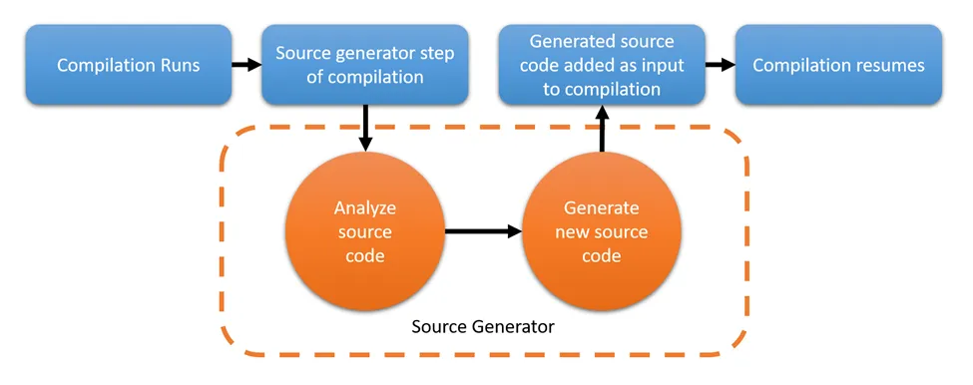
What is a Source Generator?
Aim to enable compile-time metaprogramming
Will be able to read the contents of the compilation before running,
Access any additional files, enabling generators to introspect both user C# code and generator-specific files.
Generators create a pipeline, starting from base input sources and mapping them to the output they wish to produce.

Slide 3
What Are Source Generators Not Meant to Do
Source generators are not designed to replace new language features
Code rewriting: includes, but is not limited to:
Optimization
Logging injection
IL Weaving
Call site re-writing
A source generator is also not an Analyzer.

Slide 4
Incremental Source Generator?
The .NET team has decided to deprecate source generators implementing “ISourceGenerator” in favor of incremental generators
A source generator that performs its evaluation and execution on items only after they pass some filtering requirements, significantly increasing performance.

